Slide 1


Get To The Point:
Summarization with Pointer-Generator Networks
Abigail See* Peter J. Liu⁺ Christopher Manning* *Stanford NLP ⁺Google Brain
1st August 2017

Slide 2
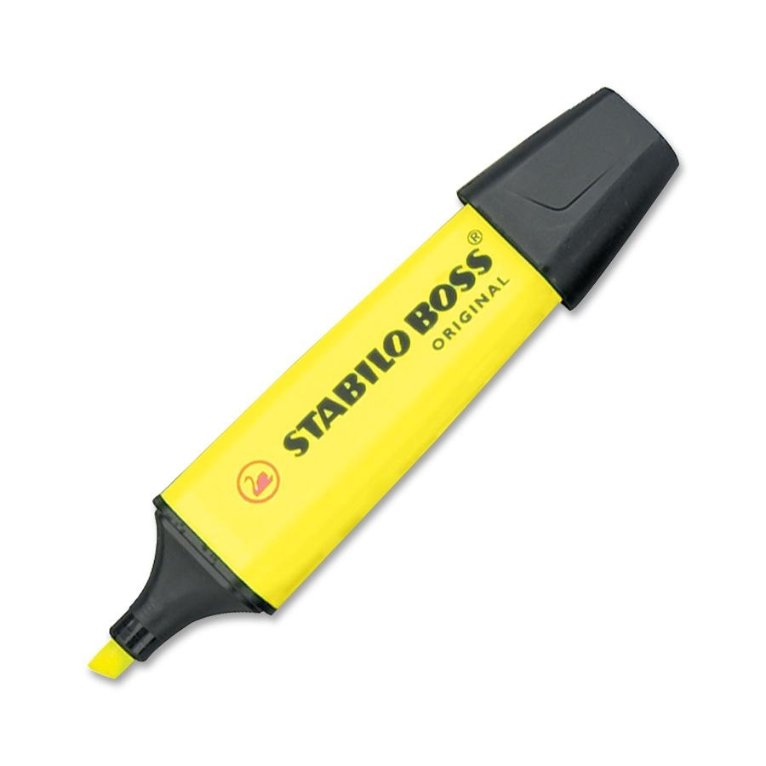

Two approaches to summarization
Extractive Summarization
Select parts (typically sentences) of the original text to form a summary.
Abstractive Summarization
Generate novel sentences using natural language generation techniques.
Easier
Too restrictive (no paraphrasing)
Most past work is extractive
More difficult
More flexible and human
Necessary for future progress

Slide 3

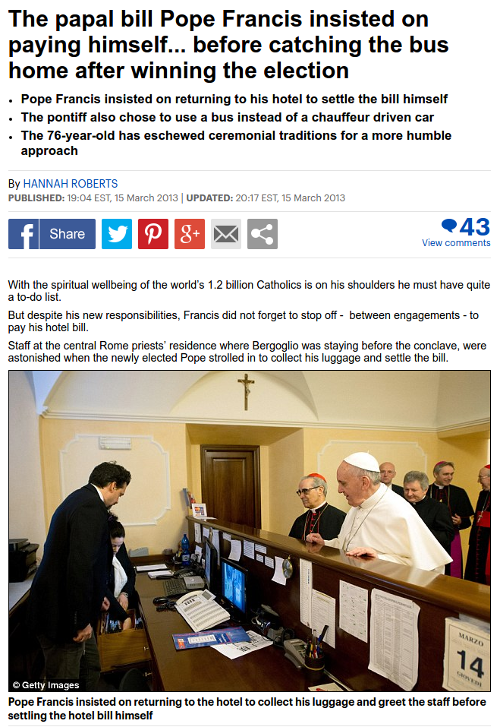
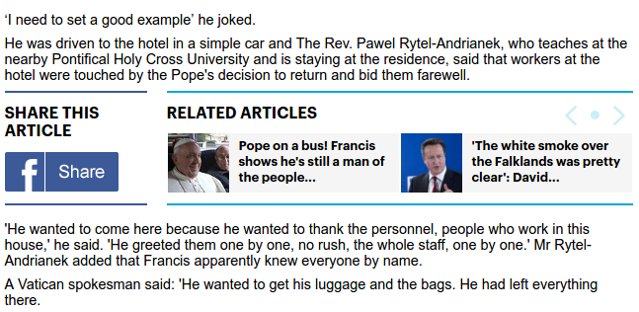
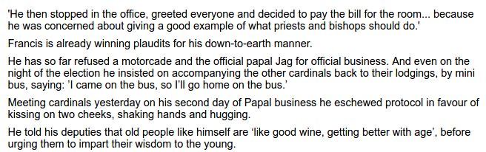
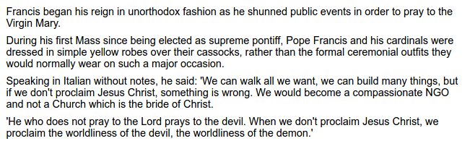
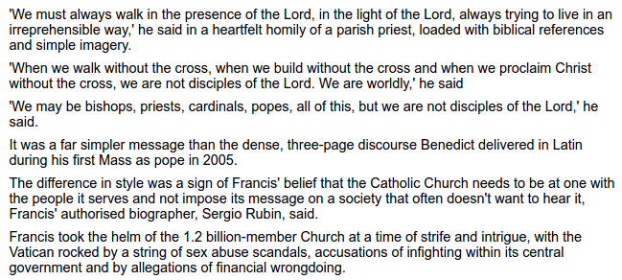
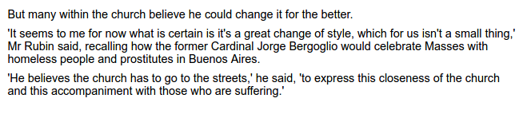
CNN / Daily Mail dataset
Long news articles (average ~800 words)
Multi-sentence summaries (usually 3 or 4 sentences, average 56 words)
Summary contains information from throughout the article

Slide 4
Sequence-to-sequence + attention model
Context Vector
"beat"
Vocabulary Distribution
weighted sum
weighted sum
Attention Distribution
a
zoo
Encoder Hidden States
...
Decoder Hidden States
Germany emerge victorious in 2-0 win against Argentina on Saturday ...
<START>
Germany
Source Text
Partial Summary

Slide 5
Sequence-to-sequence + attention model
beat
Encoder Hidden States
...
Decoder Hidden States
Germany emerge victorious in 2-0 win against Argentina on Saturday ...
<START>
Germany
Source Text
Partial Summary

Slide 6
Sequence-to-sequence + attention model
Germany
beat
Argentina
2-0
<STOP>
Encoder Hidden States
...
Germany emerge victorious in 2-0 win against Argentina on Saturday ...
<START>
Source Text

Slide 7
Two Problems
Problem 1: The summaries sometimes reproduce factual details inaccurately.
e.g. Germany beat Argentina 3-2
Incorrect rare or out-of-vocabulary word
Solution: Use a pointer to copy words.
Problem 2: The summaries sometimes repeat themselves.
e.g. Germany beat Germany beat Germany beat…

Slide 8

Get to the point!
point!
generate!
point!
point!
Germany
beat
Argentina
2-0
...
...
...
Germany emerge victorious in 2-0 win against Argentina on Saturday ...
Best of both worlds: extraction + abstraction
Source Text
[1] Incorporating copying mechanism in sequence-to-sequence learning. Gu et al., 2016. [2] Language as a latent variable: Discrete generative models for sentence compression. Miao and Blunsom, 2016.

Slide 9
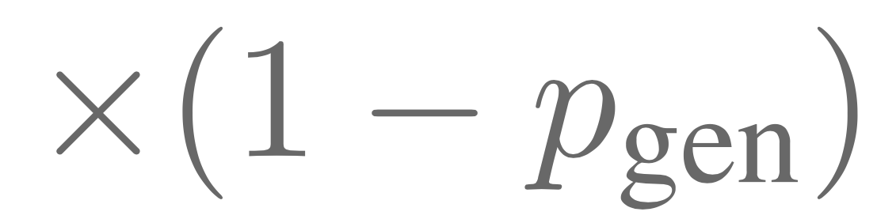

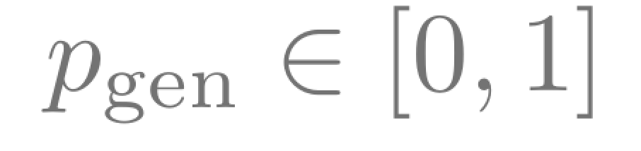
Pointer-generator network
Final Distribution
"Argentina"
"2-0"
a
zoo
Context Vector
Vocabulary Distribution
a
zoo
Attention Distribution
Encoder Hidden States
...
Decoder Hidden States
Germany emerge victorious in 2-0 win against Argentina on Saturday ...
<START>
Germany
beat
Source Text
Partial Summary

Slide 10
Improvements
Before | After
UNK UNK was expelled from the dubai open chess tournament | gaioz nigalidze was expelled from the dubai open chess tournament
the 2015 rio olympic games | the 2016 rio olympic games

Slide 11
Two Problems
Problem 1: The summaries sometimes reproduce factual details inaccurately.
e.g. Germany beat Argentina 3-2
Solution: Use a pointer to copy words.
Problem 2: The summaries sometimes repeat themselves.
e.g. Germany beat Germany beat Germany beat…
Solution: Penalize repeatedly attending to same parts of the source text.

Slide 12
Reducing repetition with coverage
Coverage = cumulative attention = what has been covered so far
Use coverage as extra input to attention mechanism.
Penalize attending to things that have already been covered.
[4] Modeling coverage for neural machine translation. Tu et al., 2016, [5] Coverage embedding models for neural machine translation. Mi et al., 2016 [6] Distraction-based neural networks for modeling documents. Chen et al., 2016.

Slide 13
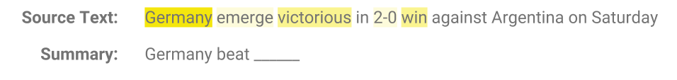
Reducing repetition with coverage
Coverage = cumulative attention = what has been covered so far
Don't attend here
Use coverage as extra input to attention mechanism.
Penalize attending to things that have already been covered.
Result: repetition rate reduced to level similar to human summaries
[4] Modeling coverage for neural machine translation. Tu et al., 2016, [5] Coverage embedding models for neural machine translation. Mi et al., 2016 [6] Distraction-based neural networks for modeling documents. Chen et al., 2016.

Slide 14
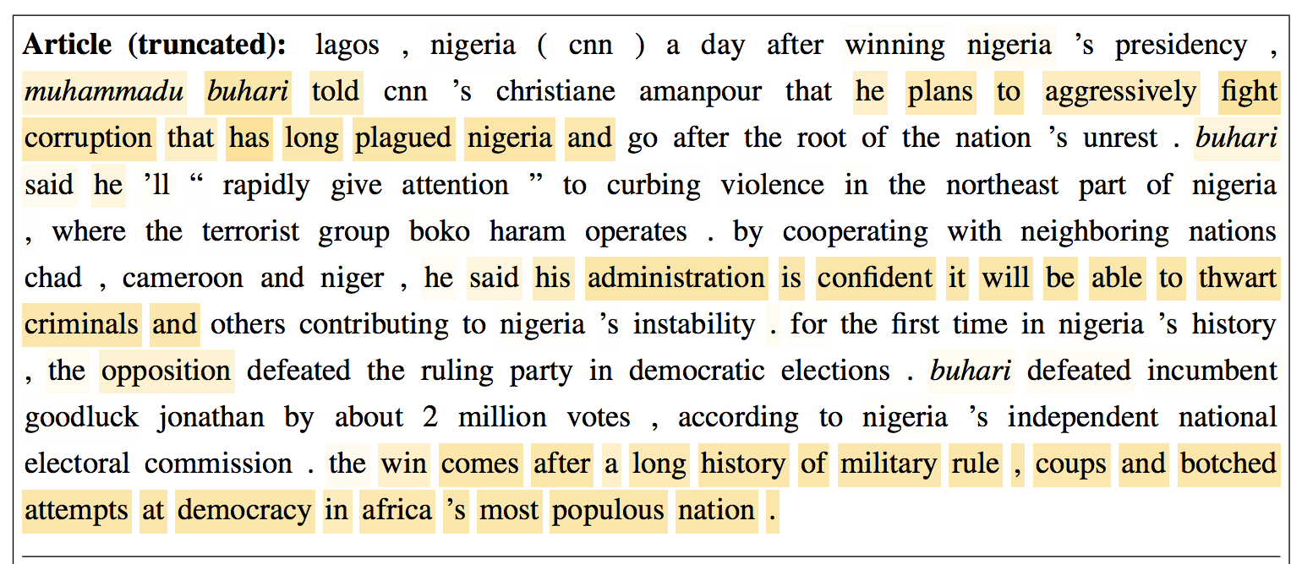
Summaries are still mostly extractive
Source Text
Final Coverage

Slide 15
Results
ROUGE compares the machine-generated summary to the human-written reference summary and counts co-occurrence of 1-grams, 2-grams, and longest common sequence.
 | ROUGE-1 | ROUGE-2 | ROUGE-L
Nallapati et al. 2016 | 35.5 | 13.3 | 32.7
Ours (seq2seq baseline) | 31.3 | 11.8 | 28.8
Ours (pointer-generator) | 36.4 | 15.7 | 33.4
Ours (pointer-generator + coverage) | 39.5 | 17.3 | 36.4
Paulus et al. 2017 (hybrid RL approach) | 39.9 | 15.8 | 36.9
Paulus et al. 2017 (RL-only approach) | 41.2 | 15.8 | 39.1
Previous best abstractive result
Our improvements
worse ROUGE; better human eval
better ROUGE; worse human eval

Slide 16
Results
ROUGE compares the machine-generated summary to the human-written reference summary and counts co-occurrence of 1-grams, 2-grams, and longest common sequence.
 | ROUGE-1 | ROUGE-2 | ROUGE-L
Nallapati et al. 2016 | 35.5 | 13.3 | 32.7
Ours (seq2seq baseline) | 31.3 | 11.8 | 28.8
Ours (pointer-generator) | 36.4 | 15.7 | 33.4
Ours (pointer-generator + coverage) | 39.5 | 17.3 | 36.4
Paulus et al. 2017 (hybrid RL approach) | 39.9 | 15.8 | 36.9
Paulus et al. 2017 (RL-only approach) | 41.2 | 15.8 | 39.1
Previous best abstractive result
Our improvements
worse ROUGE; better human eval
better ROUGE; worse human eval

Slide 17
Results
ROUGE compares the machine-generated summary to the human-written reference summary and counts co-occurrence of 1-grams, 2-grams, and longest common sequence.
 | ROUGE-1 | ROUGE-2 | ROUGE-L
Nallapati et al. 2016 | 35.5 | 13.3 | 32.7
Ours (seq2seq baseline) | 31.3 | 11.8 | 28.8
Ours (pointer-generator) | 36.4 | 15.7 | 33.4
Ours (pointer-generator + coverage) | 39.5 | 17.3 | 36.4
Paulus et al. 2017 (hybrid RL approach) | 39.9 | 15.8 | 36.9
Paulus et al. 2017 (RL-only approach) | 41.2 | 15.8 | 39.1
Previous best abstractive result
?
Our improvements
worse ROUGE; better human eval
better ROUGE; worse human eval

Slide 18
The difficulty of evaluating summarization
Summarization is subjective
There are many correct ways to summarize

Slide 19
The difficulty of evaluating summarization
Summarization is subjective
There are many correct ways to summarize
ROUGE is based on strict comparison to a reference summary
Intolerant to rephrasing
Rewards extractive strategies

Slide 20
The difficulty of evaluating summarization
Summarization is subjective
There are many correct ways to summarize
ROUGE is based on strict comparison to a reference summary
Intolerant to rephrasing
Rewards extractive strategies
Take first 3 sentences as summary → higher ROUGE than (almost) any published system
Partially due to news article structure

Slide 21

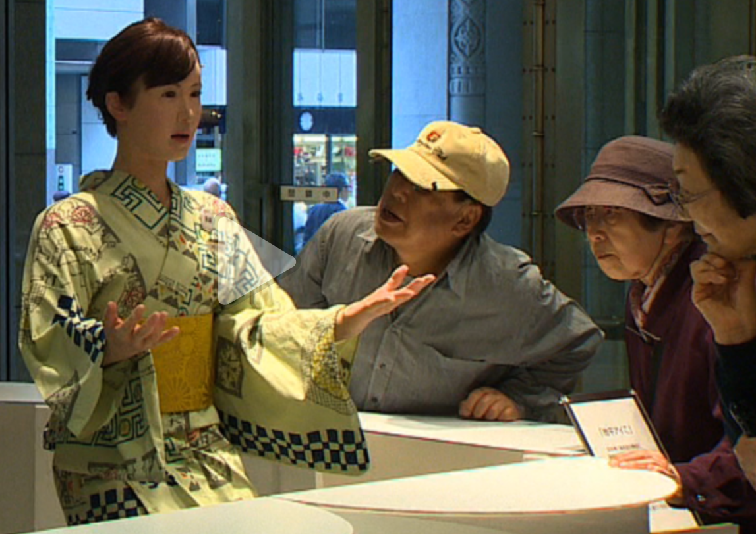
First sentences not always a good summary
Robots tested in Japan companies
A crowd gathers near the entrance of Tokyo's upscale Mitsukoshi Department Store, which traces its roots to a kimono shop in the late 17th century.
Fitting with the store's history, the new greeter wears a traditional Japanese kimono while delivering information to the growing crowd, whose expressions vary from amusement to bewilderment.
It's hard to imagine the store's founders in the late 1600's could have imagined this kind of employee.
That's because the greeter is not a human -- it's a robot.
Aiko Chihira is an android manufactured by Toshiba, designed to look and move like a real person.
...
Irrelevant
Our system starts here

Slide 22
What next?

Slide 23



Human-level summarization
more high-level understanding?
more scalability?
better metrics?
repetition
long text understanding
paraphrasing
RNNs
nonsense
copying errors
RNNs
MOUNT ABSTRACTION
SWAMP OF BASIC ERRORS
Extractive methods
SAFETY

Slide 24
Thank you!
Blog post: www.abigailsee.com Code: github.com/abisee/pointer-generator

